Slide 1
Deep Learning Enhanced CFD for Modeling External Flow
Hirthick Kumaran N
Adithya B
Gokulnath

Slide 2
Content
Introduction
Literature Review
Problem Identification & Motivation
Gantt Chart
References

Slide 3
Introduction
Advances in using computational fluid dynamics (CFD) have greatly increased due to its great potential to save time in the design process compared to experimental testing for data acquisition. Additionally, in real-life tests, a limited number of quantities are measured at a time, while in a CFD analysis all desired quantities can be measured at once, and with a high resolution in space and time.
Navier-Stokes equations require a discretized numerical approach to be solved efficiently (mainly due to their highly nonlinear convective term)
Drawbacks of CFD
Requires high computational power
More computation time
Convergence issues

Slide 4
Introduction
Using ML for CFD
Improved computing time
Lesser computing power required
Physics-Informed Neural Networks (PINN) are neural networks encoding the problem governing equations, such as Partial Differential Equations (PDE), as a part of the neural network.

Slide 5
Intro -Notes
Drawbacks: Still, CFD simulations require a lot of computational power and time to solve. They are also prone to convergence issues and need really good mesh.
Advances in using computational fluid dynamics (CFD) software have greatly increased due to its great potential to save time in the design process compared to experimental testing for data acquisition. Additionally, in real-life tests, a limited number of quantities are measured at a time, while in a CFD analysis all desired quantities can be measured at once, and with a high resolution in space and time.
Still, CFD simulations require a lot of computational power and time to solve. They are also prone to convergence issues and need really good mesh.
Navier-Stokes equations require proper numerical approach to be solved efficiently (mainly due to their highly nonlinear convective term). For example FEM is not a good choice, unlike FVM.
ML: Machine learning (ML) is a type of artificial intelligence (AI) that allows software applications to become more accurate at predicting outcomes without being explicitly programmed to do so. This is applied to CFD to efficiently solve the governing PDEs.

Slide 6
Literature Review
Physics-informed deep learning has drawn tremendous interest in recent years to solve computational physics problems, whose basic concept is to embed physical laws to constrain/inform neural networks, with the need of less data for training a reliable model.
DNN essentially has the capacity of approximating the latent solutions for PDEs [8, 9], with distinct benefits summarized as follows: (1) the superior interpolation ability of DNN, (2) the approximated solution has a close form with its infinite derivative continuous, and (3) state-of-the-art hardware advances make the numerical implementation and parallelization extremely convenient.
Guo et. al, 2020 [1] introduces physical constraints for the PDE in the NN as a regularization which has been observed to accelerate the learning of the network
Chengping et. al, 2020 [2] proposes a mixed-variable scheme of physics-informed neural network (PINN) for fluid dynamics and apply it to simulate steady and transient laminar flows at low Reynolds numbers.
Iskhakov, Dinh, 2020 [3] Navier-Stokes equations are solved using the Tensorflow ML library for Python programming language via the Chorin’s projection method.

Slide 7
Problem Identification & Motivation
Objective: Enhance the speed of CFD; Reduce computational power requirement of CFD to facilitate access to everyone; To come up with a versatile deep learning based solver for everyone to benefit from
how to better introduce physical information into neural networks and the possible non-convergence problem in loss function optimization
Literature Gap:

Slide 8
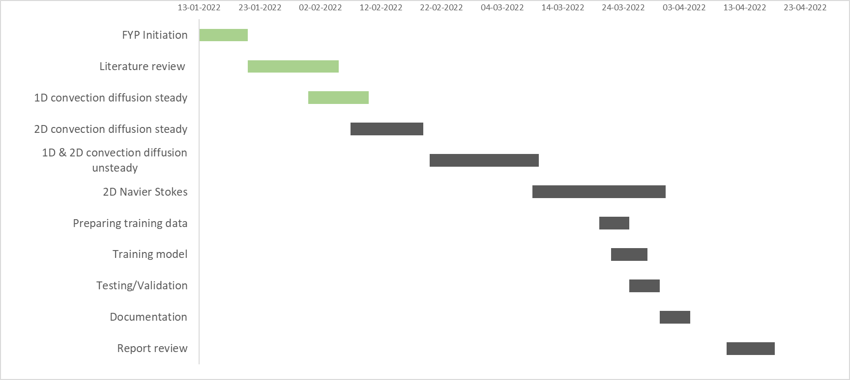
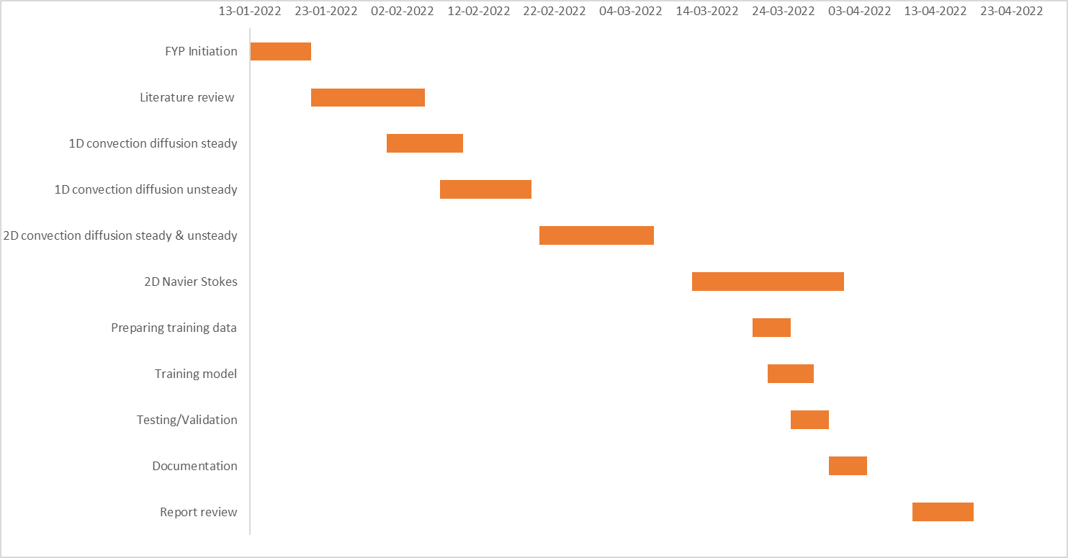
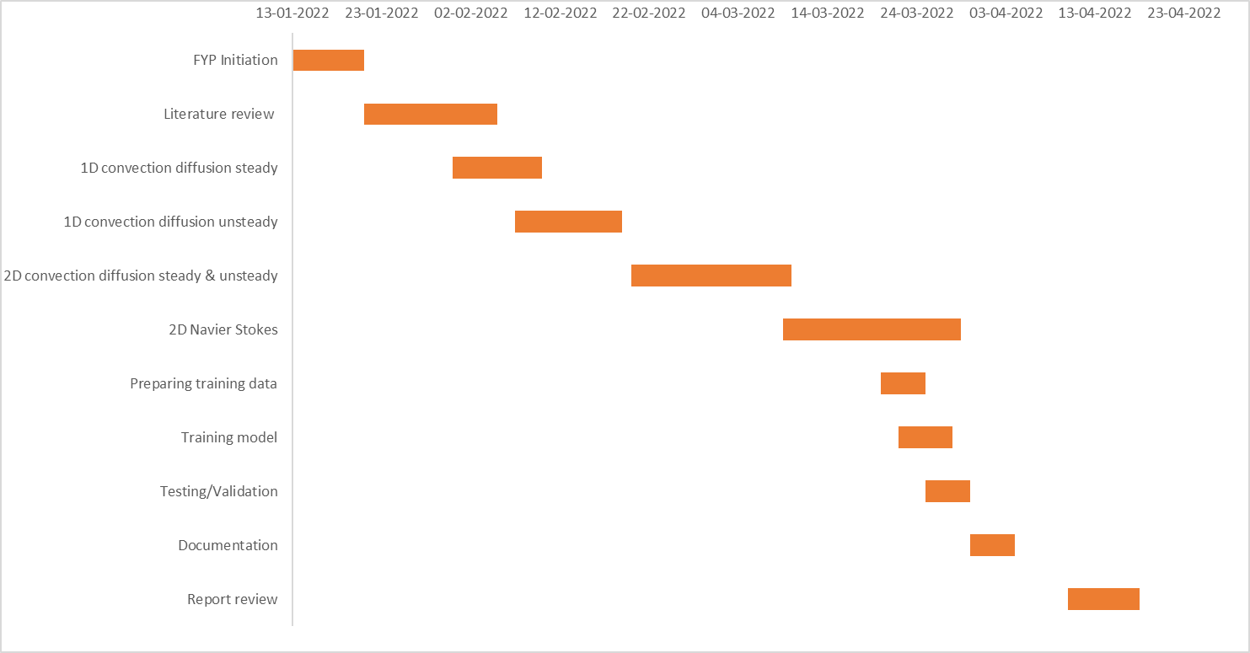
Gantt Chart

Slide 9
References
[1]
[2] Guo Y, Cao X, Liu B, Gao M. Solving Partial Differential Equations Using Deep Learning and Physical Constraints. Applied Sciences. 2020; 10(17):5917. https://doi.org/10.3390/app10175917
[3] Chengping Rao, Hao Sun, Yang Liu, Physics-informed deep learning for incompressible laminar flows, Theoretical and Applied Mechanics Letters (2020), https://doi.org/10.1016/j.taml.2020.01.039
[4] Arsen S. Iskhakov, Nam T. Dinh. PHYSICS-INTEGRATED MACHINE LEARNING: EMBEDDING A NEURAL NETWORK IN THE NAVIER-STOKES EQUATIONS. PART I, Physics Letters A. 2021; https://doi.org/10.1016/j.physleta.2021.127456

